Slide 1
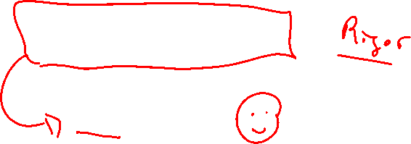
Section 2.5 Continuity
Lecture 1
Limits simplified

Slide 2

Homework Submission to Canvas
Preview of section
Skim the section in text and write a short paragraph summary.
Give a bulleted list of all important definitions, theorems, and formulas without details.
Notes on video lectures
Take notes on everything written on slides including all details, worked examples, on-own activities, as well as your own thoughts and questions.
Try on-own activities first, then write down provided solution next to it for comparison.
Worked examples from the text
Write down the problem and attempt without looking at the solution.
Use the solution to write the best explanation you can.
Solutions to textbook exercises
Model approaches and explanations given in the video lectures and textbook examples.
Final reflection of section
List the key takeaways to remember as a bulleted list.
Video reflection (for some sections)
Write a 1 paragraph reflection on the video discussing what you found most interesting or useful.

Slide 3
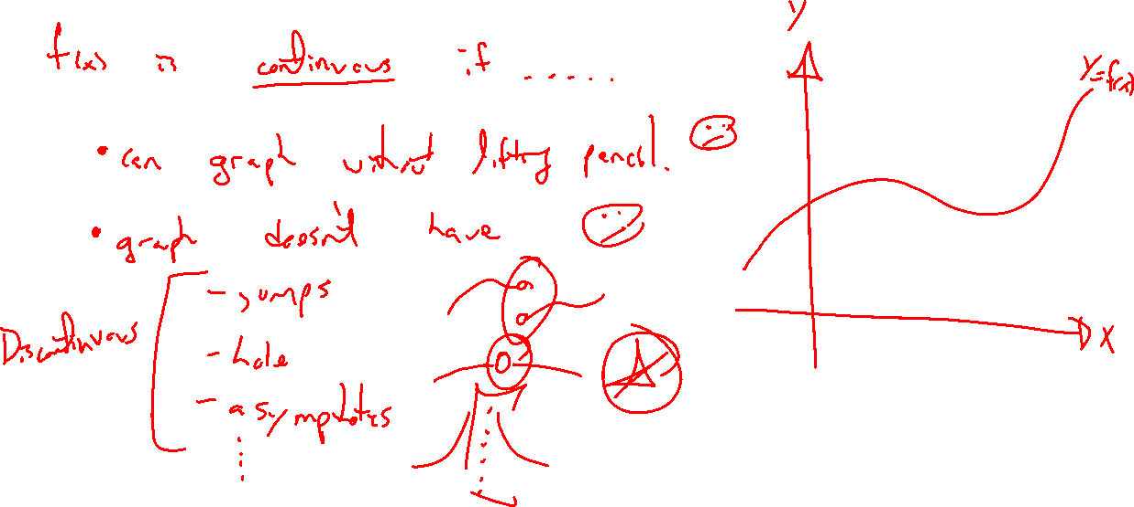
Recall: Continuous functions
Notes:
Seen before. Only have a fuzzy definition.
Graph can be drawn without lifting pencil
- no jumps, holes, asymptotes, etc.
Not precise enough (sin(1/x)), Dirichlet function
Need to be precise if want to build a theory on this idea (most ubiquitous math idea from this class)

Slide 4
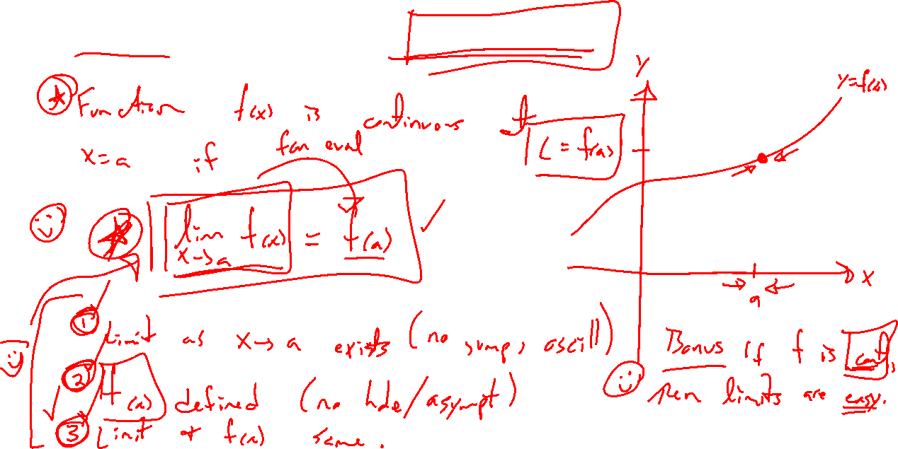
Precise definition of continuity
Notes:
Write down first, then draw picture.
Value: If can show a class of function is continuous (ie polynomials), then limit calculation is easy, same a fcn eval.
Three things involved: limit exists(two sides), function defined there, they match

Slide 5
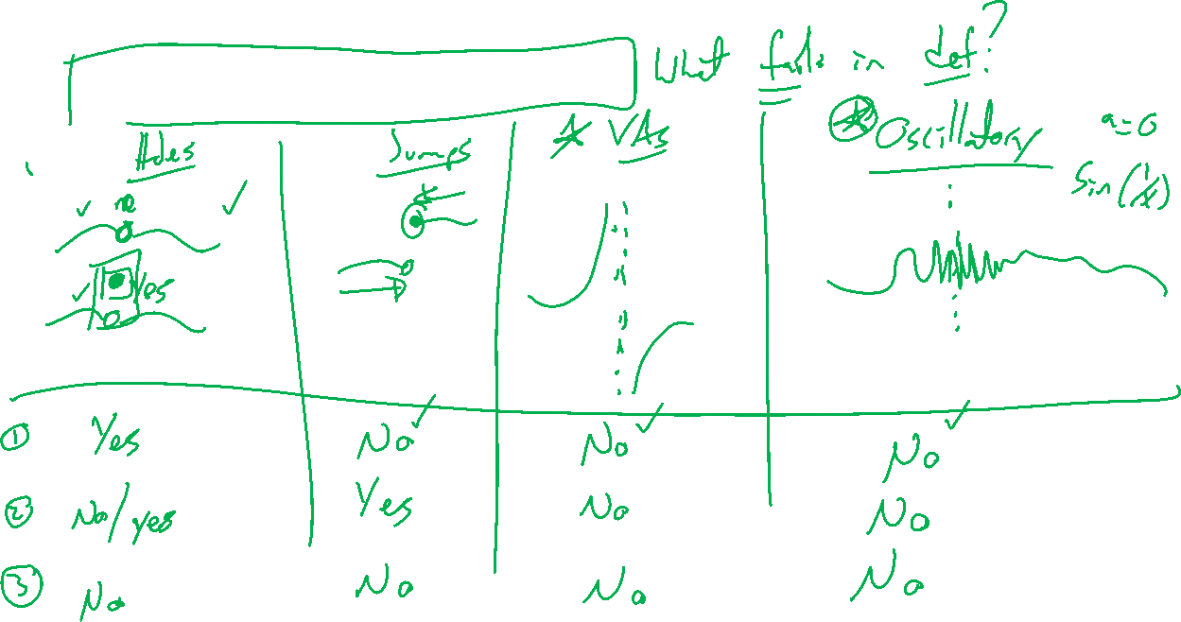
Discontinuous functions
Notes:
One of the three items fail: List possibilities.
- removable, jump, asymptote, oscillation

Slide 6
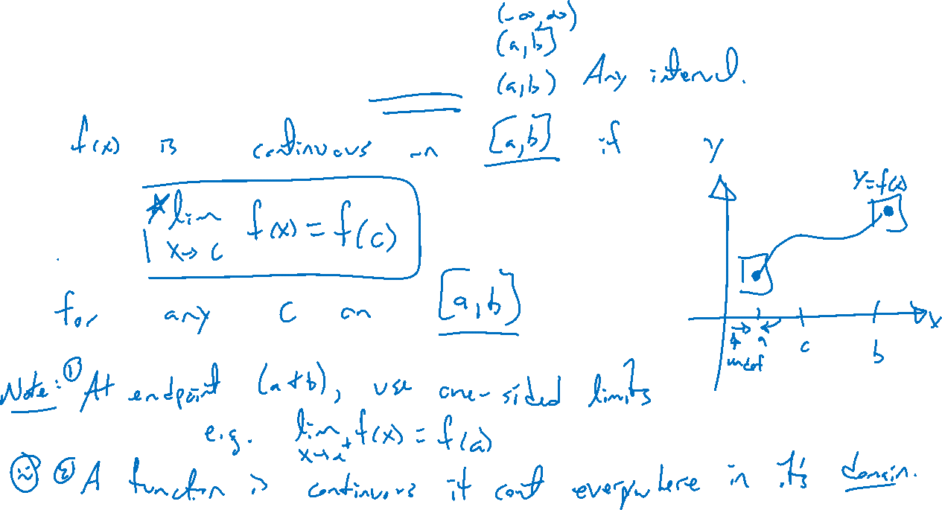
Continuity on an interval
Notes:
A function is continuous on an interval if continuous at every x value in the said interval.
Right / left continuity can be used here.
Continuous functions are continuous everywhere in their domain.

Slide 7
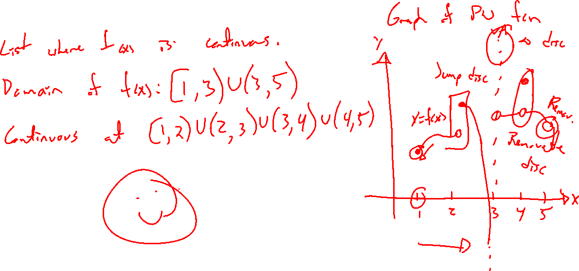
Example: Try on own
Notes:
List everywhere the function is continuous. Right / left continuous considered.
PW function, removable, jump, asymptote, not in domain

Slide 8
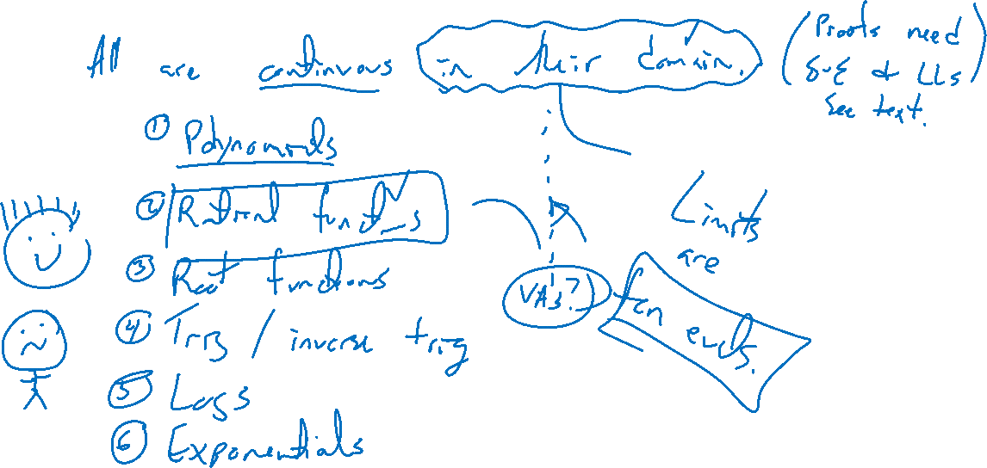
Theorem: Classes of continuous functions
Notes:
Poly, rationals, root, trig, inv trig, log, exp
Note all are continuous in their domain
Each needs a careful proof using limit laws. See text.

